Slide 1
WEB SCRAPING OF SKYTRAX INSIGHTS
BRITISH AIRWAYS
2022-11-22

Slide 2
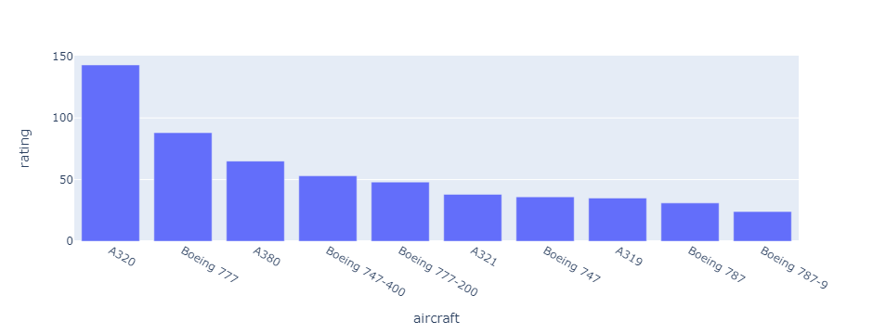
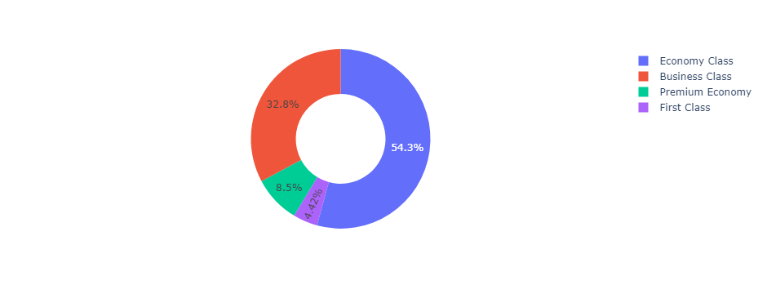
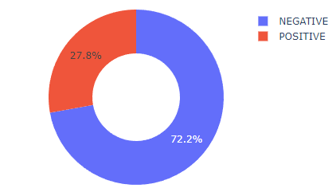
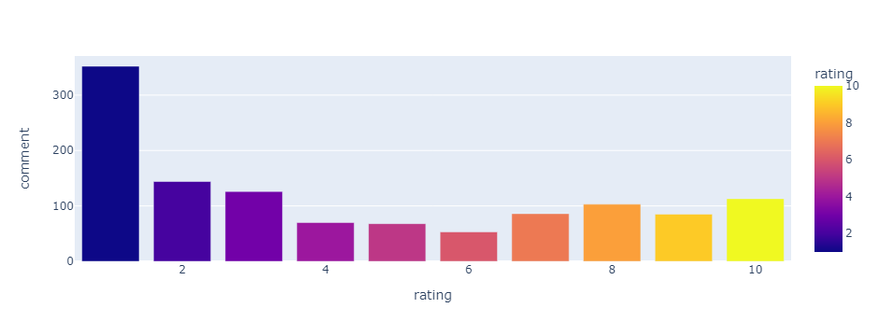
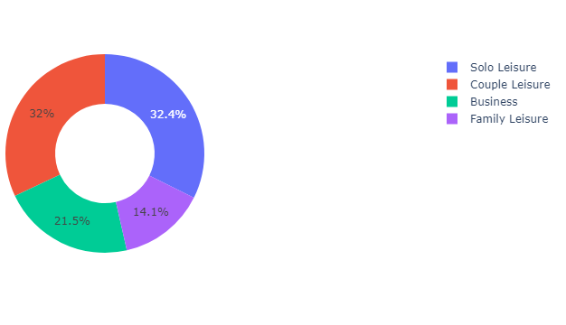
INSIGHT SUMMARY
Most of our passenger fly with A320, Boeing 777, A380, Boeing 747 and A321. Most reviewers are solo leisure and choose to fly with Economy class.
However, most of reviewers left bad review rating number. Based on sentimental model analysis, 72.2% left negative reviews, only 27.8% had positive impressions.

